Slide 1
Warm Up Presentation 1
Presented by:
Kazi Amit Hasan
School of Computing, Queen’s University

Slide 2
Why these two papers?
A Cyber-Physical System to Detect IoT Security Threats of a Smart Home Heterogeneous Wireless Sensor Node
- Authors: AKM Jahangir Alam Majumder et al.
- Publication year: 2020
- Publisher: IEEE (Access)
Siamese Neural Network Based Few-Shot Learning for Anomaly Detection in Industrial Cyber-Physical Systems
- Authors: Xiaokang Zhou et al.
- Publication year: 2021
- Publisher: IEEE Transactions on Industrial Informatics

Slide 3
A Cyber-Physical System to Detect IoT Security Threats of a Smart Home Heterogeneous Wireless Sensor Node
Authors:
AKM Jahangir Alam Majumder, Charles B. Veilleux, Jared D. Miller
Division of Mathematics and Computer Science, University of South Carolina Upstate (USA)

Slide 4
Background & Motivation
Between 2019 and 2030 the number of IoT connected devices in the world will grow from 7.6 billion to 24.1 billion, with revenue more than tripling from $465 billion to over $1.5 trillion. [1]
Largest Applications: Security, Electric Smart Meters, Payment Processing's etc
‘Things’ in the IoT can benefit homes, factories, cities. But also can introduce security risks. [2]
IoT devices are lack of security because they lack of necessary built in security of counter threats.

Slide 5
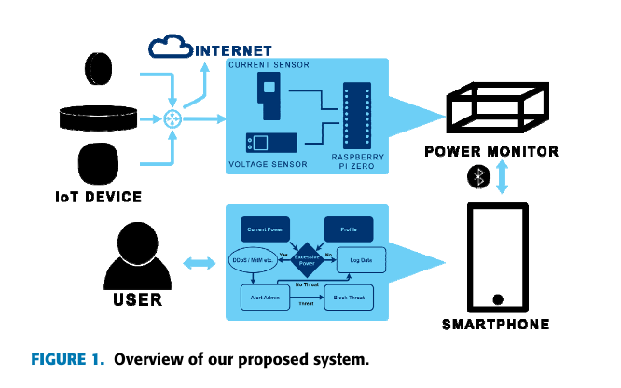
Proposed Approach
Presented a smart CPSS to detect IoT threads
Based on behavioral profiling
Used statistical signal processing and multivariant logistic regression models
Can be used in:
energy management system
Smart home EMS for security analytics
As a service in the cloud

Slide 6
Major Contributions
Developed a smart Cyber-Physical System (CPS) to detect cybersecurity threats through behavioral profiling
Proposed proactive and provable monitoring of power uses in smart IoT devices using a smartphone.
Used a general multivariate regression model and statistical signal classification techniques to detect abnormal power behavior and notify the admin.

Slide 7
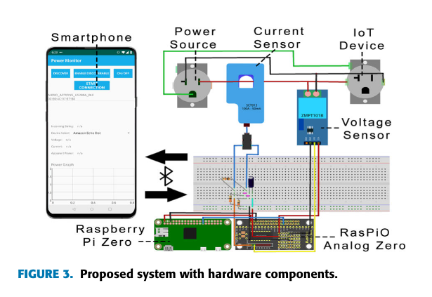
System architecture
Consists of:
Rasberry Pi Zero
RasPiO Analog Zero
YHDC SCT013 current sensor
ZMPT101B voltage sensor
smartphone

Slide 8
Data Collection
A standardized test was established that could be used for any IoT device tested.
Each test lasted for 6 hours
21600 data points were collected.
IoT Devices used were the Amazon Alexa Echo Dot 2nd Gen, 3rd Gen SmartThings Hub, and Avatar Mini Smart Socket
Each test was made up of 6 scenarios:
One hour in an idle state.
One hour in an active state.
One hour idle in an idle state while the IoT device is under a simulated DDoS attack.
One hour active in an active state while the IoT device is under a simulated DDoS attack.
One hour idle in an idle state while the IoT device is under a real MitM attack
One hour active in an active state while the IoT device is under a real MitM attack.

Slide 9
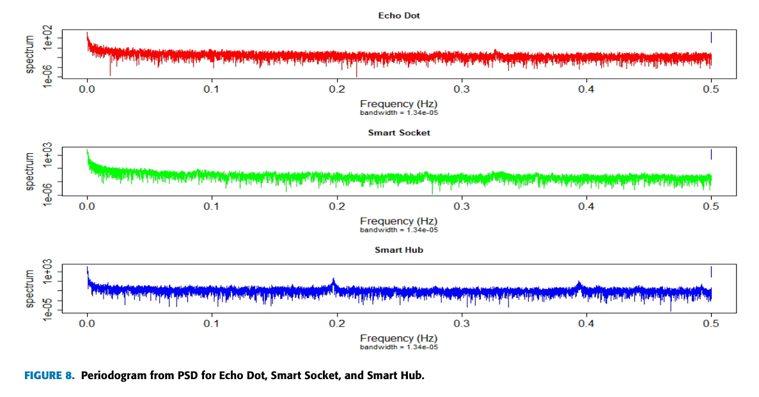
Overview of Multivariant Logistic Regression Model
Power Spectral Density: to test the signal’s power variation with frequency.
Generalized Linear Model: to predict the outcomes they’ve used logistic regression

Slide 10
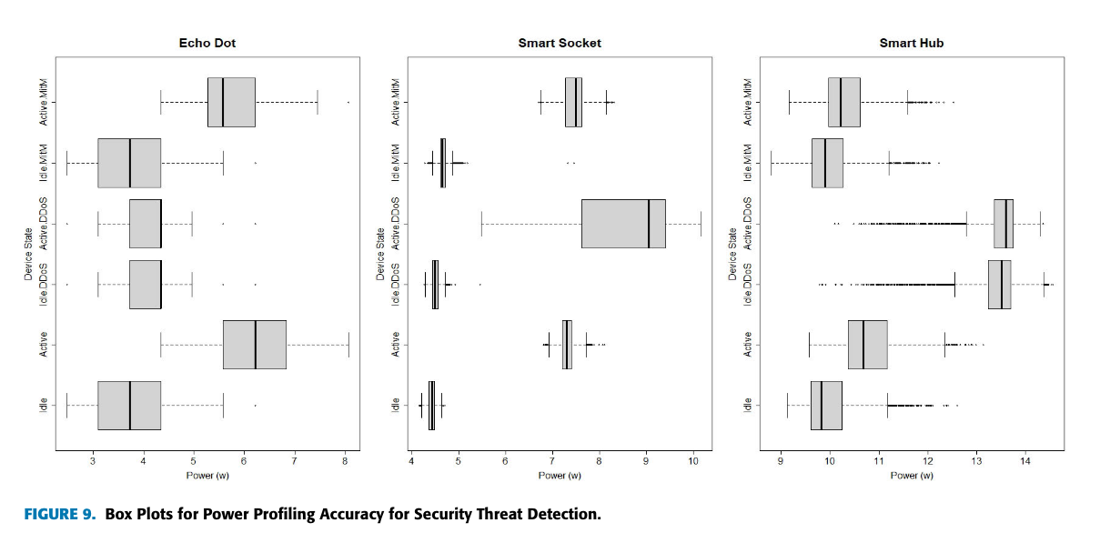
Evaluating the proposed system
We tested different smart IoT devices and observed their power variations with and without cyber threats.

Slide 11
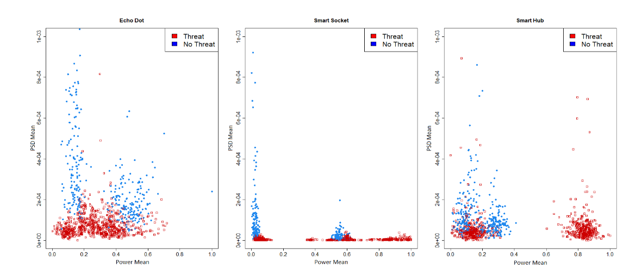
Device Based Cluster Plots

Slide 12
Evaluating the proposed system (cont.)
- Used k fold cross validation.
- Similarity between idle/active and idle/active with MitM.
Devices | Accuracy
Eco Dot Data | 89.1%
Smart Socket Data | 83.5%
Smart Hub Data | 67.9%

Slide 13
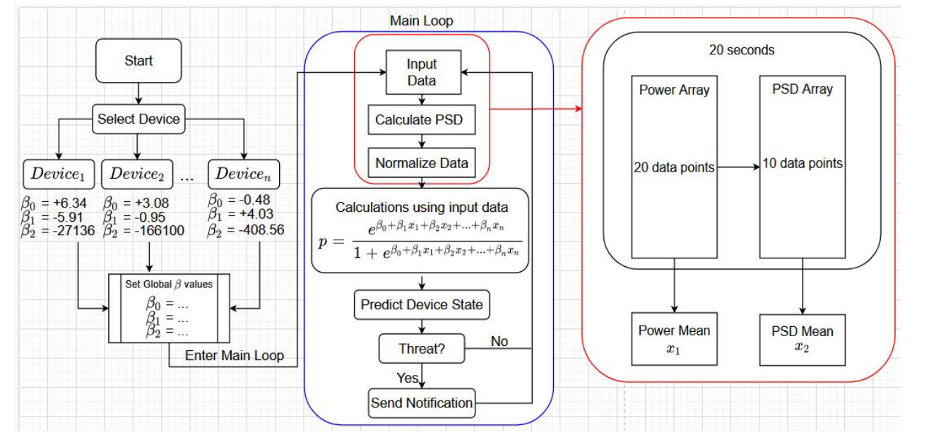
Software implementation of proposed approach

Slide 14
Opinions
- Collecting data considering 6 situations is good.
- Predictive modeling part has a good scope of improvement.
- Evaluation part can be re-evaluate with other evaluation metrics

Slide 15
Siamese Neural Network Based Few-Shot Learning for Anomaly Detection in Industrial Cyber-Physical Systems
Authors:
Xiaokang Zhou, Wei Liang, Shohei Shimizu, Jianhua Ma
Faculty of Data Science, Shiga University, Japan

Slide 16
Background and Motivation
IIoT is vulnerable to cyber and physical threats due of its diverse CPS applications across networks.
A cloud-based hybrid cyber-physical ecosystem generates a lot of industrial data.
Industrial CPS needs real-time anomaly detection with high accuracy and timeliness to mitigate malicious assaults.
Industrial CPS is also affected by the frequency of anomalous events. These anomaly activities are rare, therefore model training lacks well-labeled data.
In most industrial systems, missing surveillance data due to sensor failure, data transmitting mistake, etc., makes autonomous data gathering and model training for intelligent anomaly detection more challenging.

Slide 17
Solution?
To match the testing inference, the training sample must be carefully chosen.
Few Shot Learning
Can handle models with few samples of data
Siamese neural network based few-shot learning

Slide 18
Main Contributions
A few-shot learning model based on Siamese CNN is designed with a relative-feature representation scheme, which can alleviate the over-fitting issue especially when coping with few labeled data in industrial CPS. (FSL- SCNN)
A robust cost function
An intelligent detection algorithm is developed based on a transformed lower dimensional feature representation

Slide 19
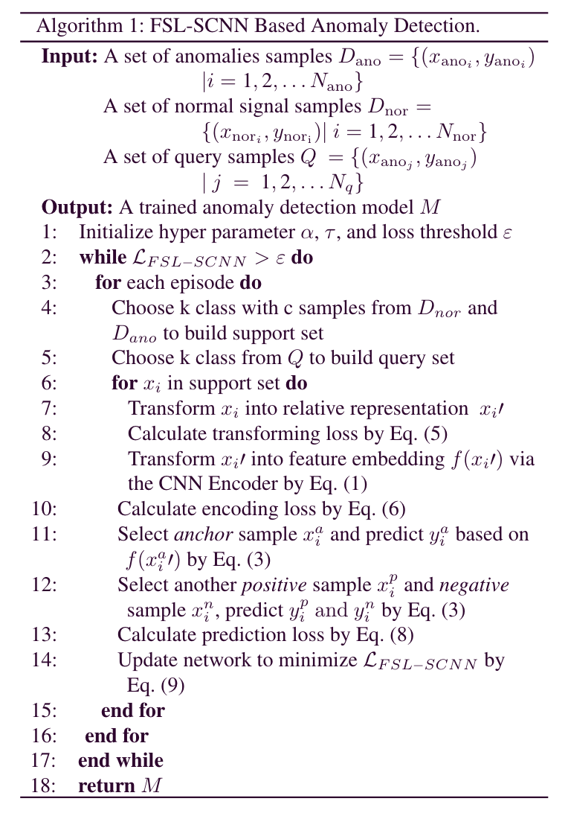
FSL-SCNN Based Anomaly Detection
Inputs:
A set of anomalies samples
A set of normal signal samples
A set of query samples

Slide 20
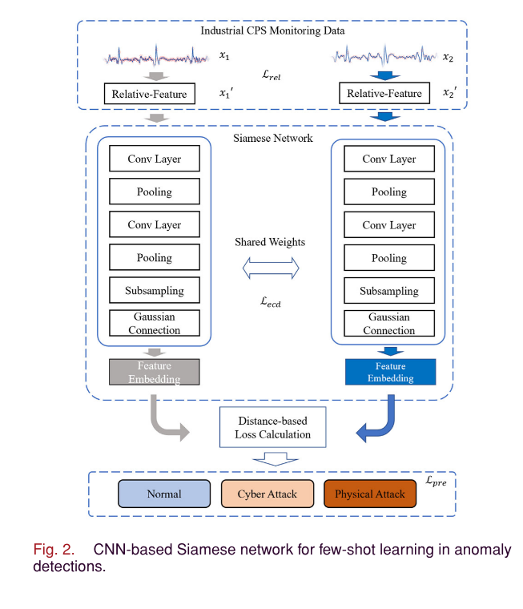
Proposed Model
FSL-SCNN do not predict the class for an input sample data directly, but calculate the distance between the input samples in terms of their optimized feature representations.
To train DL model:
Two input sample data for each class sent into two identical CNN models
Change feature dimensions (to mitigate overfitting)
During testing, the distance between two feature embeddings will be calculated to identify match.

Slide 21
Experiment and Analysis
Dataset:
Tested on both fully labeled and few labeled public dataset (UNSW-NB15)
Composed of network traffic packets
Contains nine types of CP attacks
Experimental Design:
Used TSA, NB, RF, One shot SVM, SCAE and FSL-SCNN
Used stochastic gradient descent (SGD) as the optimizer
Used precision, recall, F1, and FAR

Slide 22
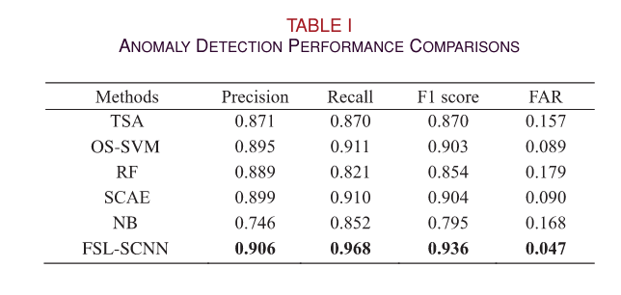
Evaluation
Used PCA to investigate all six methods
FAR is the main performance indicator in anomaly detection
FSLSCNN has achieved the best results in F1 score and FAR at 0.936 and 0.047 respectively.

Slide 23
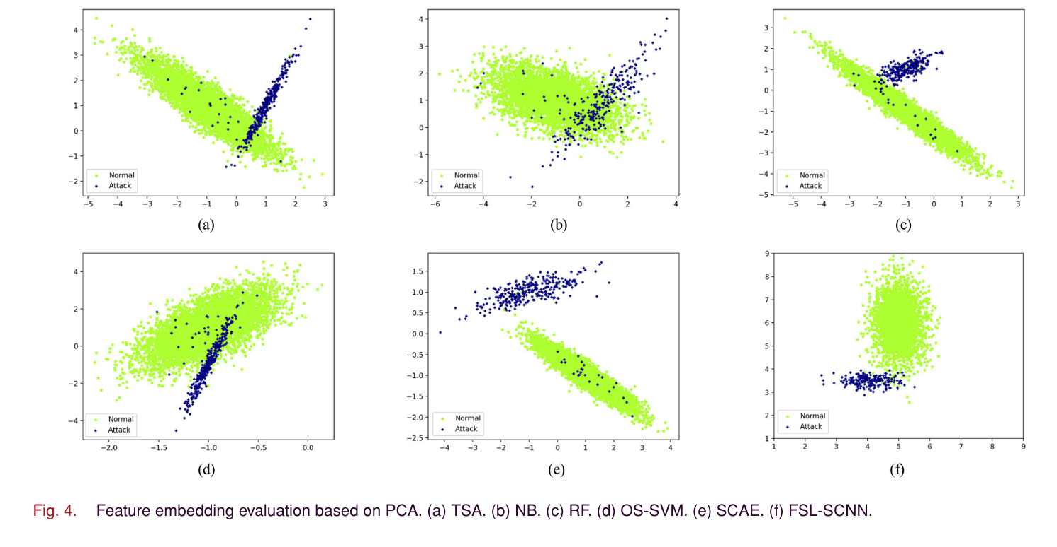
Feature embedding evaluation based on PCA

Slide 24
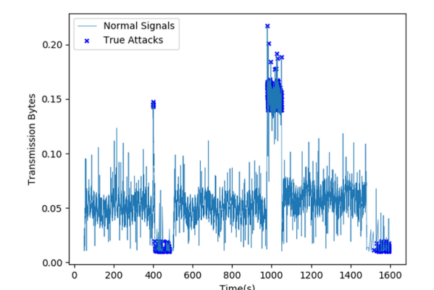
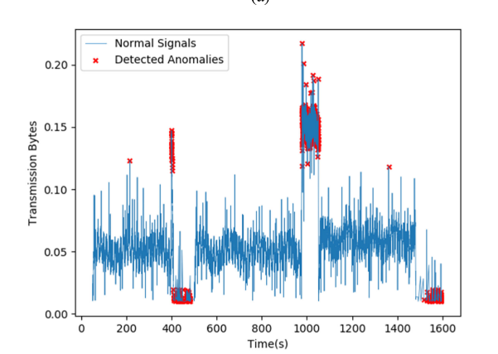
Cyber-attack analysis based on throughput statistics
True attacks
Detected anomalies

Slide 25
References
The IoT in 2030: 24 Billion Connected Things Generating $1.5 Trillion, IoT Bus. News, Reading, U.K., May 2020.
S. Kazmi, N. Javaid, M. J. Mughal, M. Akbar, S. H. Ahmed, and N. Alrajeh, ‘‘Towards optimization of Metaheuristic algorithms for IoT enabled smart homes targeting balanced demand and supply of energy,’’ IEEE Access, vol. 7, pp. 24267–24281, 2019.

Slide 26
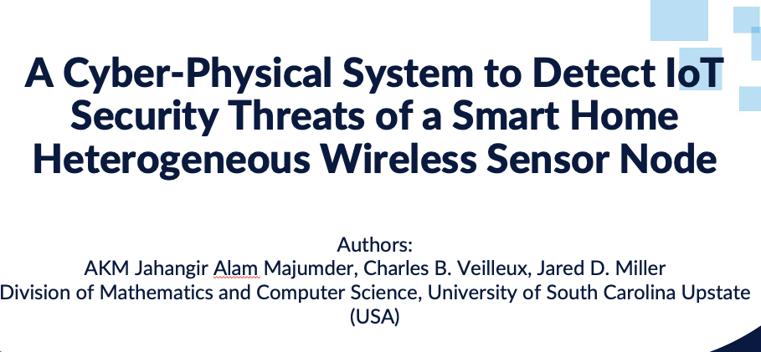

Conclusion

